Slide 1
Nine man morris
1907039 1907047

Slide 2
How it’s played:
A video Demonstration of this game is given below: Game Video
Objective: The goal of Nine Men’s Morris is to capture your opponent’s pieces by forming lines of three.
Setup:
The game board consists of three concentric squares.
Each side of each square has three points (the two corners and a midpoint).
The same-side midpoints of all three squares are connected by straight lines.
There are 24 points on the board where the playing pieces are set or can be moved to.

Slide 3
How it’s played:
Setup Phase: Players take turns placing their nine pieces on vacant points
Regular Phase: After all 18 pieces are placed, the regular phase begins. On each turn, slide one of the pieces along a line to a vacant point.
If A string of three pieces is on one line, then he can immediately remove one of his opponent’s pieces.

Slide 4
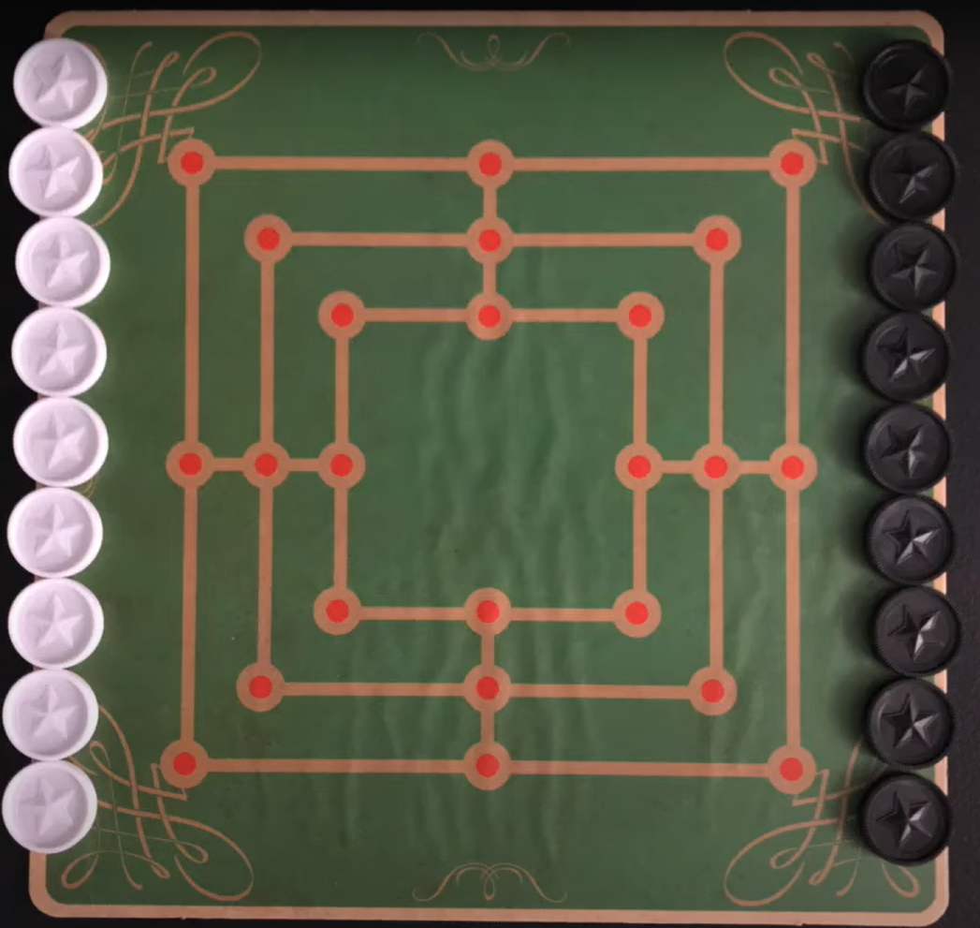
Board

Slide 5
Possible Implementation Ideas
The game will be represented using a suitable data structure (A 2D array or graph).
An evaluation function that assigns a value to a given board position
Number of mills formed, Piece count, and Board control.
Recursively evaluating possible moves using Min-Max algorithm with alpha-beta pruning.
Define fuzzy rules to handle uncertainty in evaluating board positions.
Goal state could be winning or blocking the opponent. We will use A* search to finds the shortest path

